Slide 1
First week update
Pengfei Hong

Slide 2
outline
Current existing technology and frameworks
Proposed approach
Papers
Future works
Docker

Slide 3
Proposed approach
Process the data using current tesseract knowledge:
Fill in but fine tune it to crop small piece of paper on delivery?
Tag existing datasets with prior knowledge with existing the spatial format of writing addresses. Tag it with spatial information. (each spatial tag should stands for a certain type of information)
And deal with different tags separately.
storing google map in a SQL database.
Ranking algorithm from possible datasets, with spatial information, and previous word.

Slide 4
Keyword: location NER location tagging in text
use Stanford's POS tagger with one of their pre-trained left-3-words models.
Regular expression to find postal code.
Pipeline:
Potential location terms and words around them -> open source tool Nominatim to search the OpenStreetMap database -> obtain a list of possible locations for each unique phrase -> take the one that have the highest score.
Pengfei: it involves a lot of other relevant text and related locations.
the algorithm could be improved by training part-of-speech taggers and named entity recognizers that are specically trained for the target style of text. Tagger for training a tagger.

Slide 5
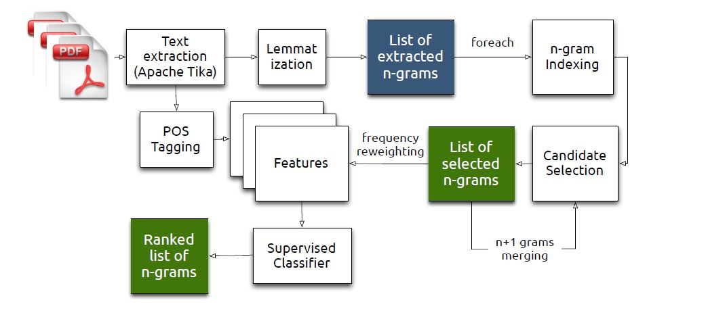
Keyword: with specific knowledge Effective Named Entity Recognition for Idiosyncratic Web Collections
We design and evaluate several entity recognition Features ranging from well-known part-of-speech tags to n-gram co-location statistics and decision trees to classify candidates.
analysis of entity-graph structures
the use of external knowledge bases yield
signicantly better results in our context

Slide 6
Keyword: NER whole architect Leveraging Knowledge Graphs for Web Search
Whole process:
Tokenization -> Sentence splitting -> Part--‐of--‐speech (POS) tagging ->Named Entity Recognition (NER) -> Co-reference resolution -> Relation extraction
Domain specific KBs and POS patterns work well

Slide 7
Leveraging Knowledge Graphs for Web Search
NER can be formulated as classification tasks.
Spatial information tag, the map dataset, and existing dataset.
ML methods for classification, decision trees, SVM, adaboost.
Sequencing models: probalistic sequence models.
CRF and HMM.

Slide 8
keyword – NER for location
http://ricedh.github.io/03-ner.html

Slide 9
Not very useful slides

Slide 10
keyword: NER architecture, and code Named Entity Recognition with Bidirectional LSTM-CNNs
word- and character-level features using a hybrid bidirectional LSTM and CNN architecture, eliminating the need for most feature engineering.
Benefits: discover long distance relation between words
encoding partial lexicon matches in neural networks and compare it to existing approaches.
Using word embeddings that can grasp word level information, and character level features, useful for bad embeddings where some word embeddings are badly trained.
Pengfei: can explore some word or character level embeddings to better recognize NER.

Slide 11
Future work
train:
Tagging algorithm based on the dataset
Bidirectional LSTM to classify which one is better. Since the word may affect each other.
How to describe the relation between two locations. Vector? Tree structure search?

